Slide 1




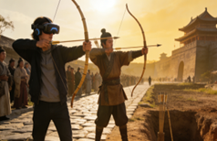
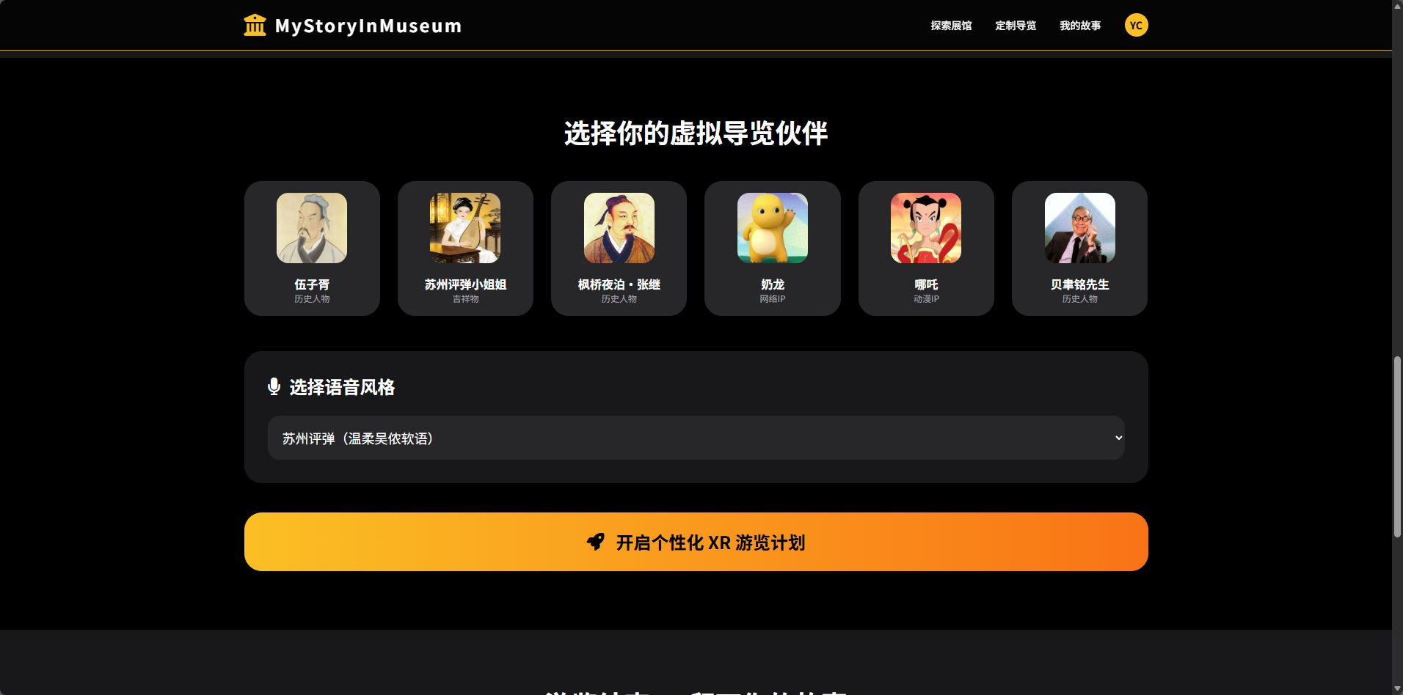
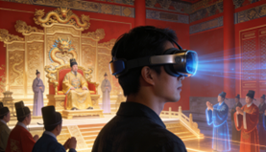
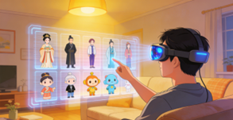
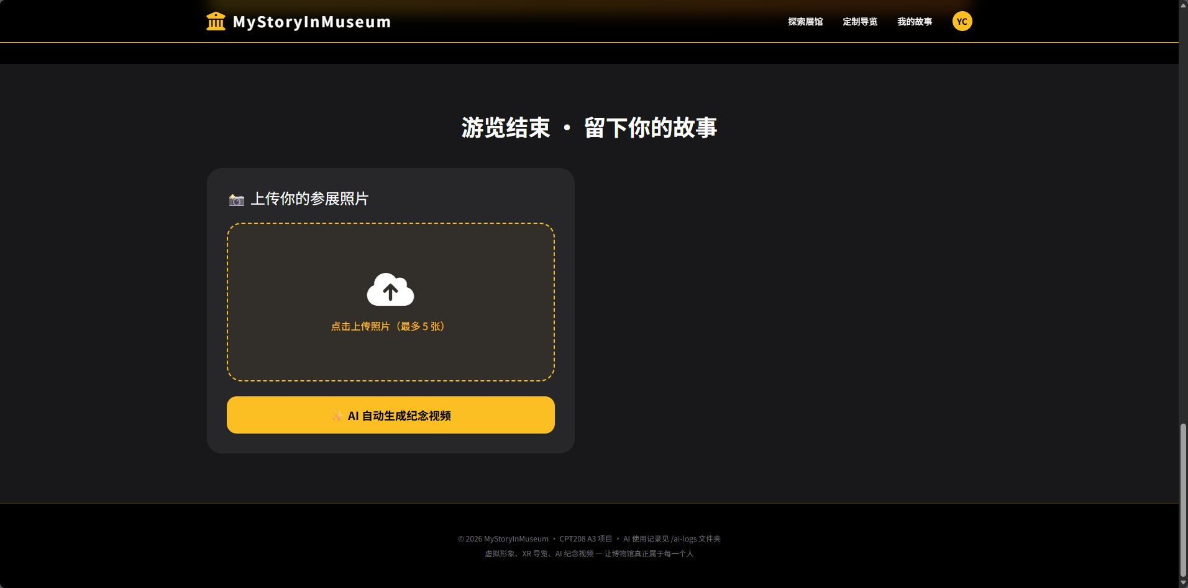
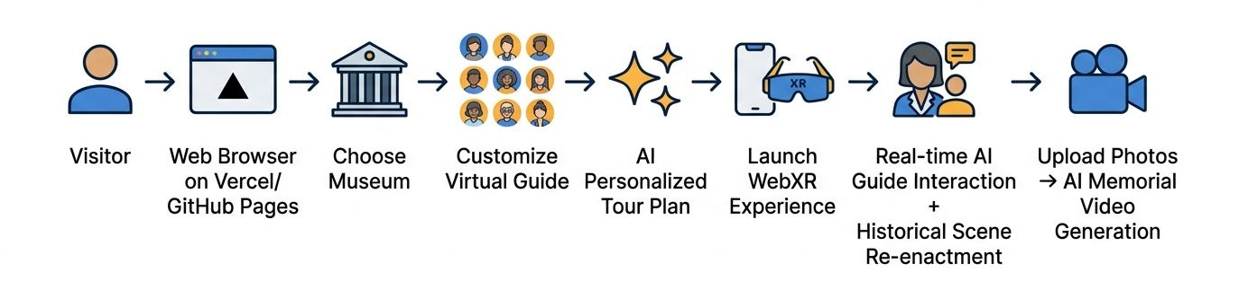
My Story In Museum: A Personalized Immersive Narrative System Based on XR and Generative AI
From "One-way Display" to "Customized Companionship": An HCD Solution for Enhancing Museum Engagement
CPT208 - Xi’an Jiaotong-Liverpool University, Suzhou, China
Yixuan Chen, Yifei Dou, Ziheng Li, Yuhan Mei
Background & Problem
Motivation
In the digital age, museums face the dual challenge of creating deep immersion while avoiding information overload. Current digital tools often fail, leaving visitors disengaged. Research shows effective experiences require active exploration and emotional connection [1], yet many solutions ignore how visitor behavior—like dwell time and personal interest—directly impacts engagement [3].
Our goal is to bridge this gap through a human-centered​ approach. We integrate XR to reconstruct authentic historical contexts for emotional impact, with generative AI to enable personalized, conversational narratives. This transforms passive viewing into an active “journey of discovery.” This philosophy aligns with applying HCI to cultural heritage, aiming to enhance understanding and accessibility for diverse learners [1,2]. Ultimately, we seek to make museum visits a memorable, participatory dialogue with history.
Prototypes & Iteration
Design Evolution Process
Our design process was centered on solving the problem of "how to blend storytelling with interaction without making visitors feel overwhelmed or bored." This core idea guided our journey from initial concept to high-fidelity prototype.
Rationale for Design Decisions
During the early stages, we seriously considered two alternative approaches that leaned more heavily on a single technology:
Alternative Option A: Pure XR Historical Recreation
Focused on creating highly immersive, photorealistic recreations of historical environments and events, allowing visitors to "travel back in time.“ It looked amazing, but it was pretty passive. There wasn't much real interaction.
Alternative Option B: Pure AI Voice Chatbot Guide
Developing a knowledgeable, conversational AI voice assistant that visitors could freely question about any exhibit. It could have natural conversations and tailor explanations to each person. That made it more engaging and accessible, but it missed the emotional punch of actually seeing history come to life.
Advantages of the Final Hybrid Option C (XR + AI):
The XR part builds the world and the atmosphere it makes you feel like you're really there in that historical moment. Then the AI voice turns that world into a conversation. Visitors can ask questions on the fly, ask for a simpler explanation, or dive deeper into something they're curious about.
That turns a one-way tour into a kind of discovery game. It's way less boring. Sure, building this hybrid system is more complicated than just picking one approach, but it's worth it. Visitors remember more, get more curious, and have a better time whether they're kids, adults, or just have different ways of learning.
High-Fidelity Prototype: Core Interface Realization
Based on the hybrid concept, we developed the complete user interface. Below are the final designs for two core screens:
Pain Points of Existing Solutions
1.Rigid Interaction: Most XR is limited to static overlays; visitors remain passive recipients, leading to rapid boredom.
2.Homogenized Content: Fixed scripts fail to cater to diverse ages and knowledge backgrounds.
3.Contextual Fragmentation: Artifacts are isolated from their historical context, missing the "emotional punch" of a lived experience.
User Personas:
Primary User: Xiao Lin (19, Student). Pain point: Views museums as "boring classrooms"; craves RPG-like exploration.
Secondary User: Museum Curator. Pain point: Needs a flexible, low-cost system to keep exhibits engaging for younger audiences.
Design Solution
Research Questions:
Can a system integrating AI-driven interactive games and XR immersion significantly boost visitor interest and proactive participation?
Can the "Customizable Guide + Immersive Scene" approach break the limits of "one-way display" and truly make history "come alive"?
Screen 1: The Starting Point for a Personalized Journey – Virtual Companion & Voice Selection
This interface is key to defining a personal experience. After choosing a museum, users can select a virtual companion from different categories (historical figures, cultural symbols, anime-inspired IPs, etc.) and pair it with a matching voice profile (e.g., "Suzhou Pingtan"). This establishes the emotional tone and interactive style for the entire tour.
RQ1
RQ2
Core Design Concept:
"Immersive Narrative + Personalized Companionship": Using XR for 1:1 historical reconstruction coupled with LLM-driven custom personas to reframe museum visits as "private cross-temporal dialogues with history."
Screen 2: The Culmination & Sharing of Experience – AI-Generated Souvenir Video
This interface represents the conclusion of the tour and is crucial for creating a personal memory. Upon tour completion, users can upload photos they took at the museum. The system then automatically generates a personalized short video souvenir by combining their tour path, interaction history, and these photos, allowing the experience to be extended and shared.
HCD & Fun Highlights:
1.XR Immersive Historical Scene Reconstruction + AI-Powered Ancient Character Interactive Games
Users can scan cultural relics with XR devices to 1:1 restore the historical moments and scenes when the relics were created. By entering the virtual historical space, they can engage in dialogues, puzzle-solving, and mission-based interactive games with virtual ancient figures. This allows users to deeply understand history and culture through an enjoyable experience, bidding farewell to the dullness of one-way sightseeing.
2.Fully Customizable Personalized XR Virtual Tour Guide Service
Users can freely choose tour guide avatars, including ancient figures, anime characters, IP mascots, etc. The system automatically matches exclusive voice tones and speaking styles corresponding to the selected persona, providing cultural relic explanations and intelligent route planning. It also supports real-time AI voice interaction and Q&A, creating a unique, companion-like museum tour experience.
3.AI-Driven Personalized Tour Adaptation
Based on users’ interests and visiting pace, AI dynamically adjusts the depth of explanations and recommends tour routes, realizing a highly customized “thousand people, thousand faces” guided experience. This balances fun and practicality to meet the diverse museum-visiting needs of different users.
Evaluation & Value
Project Value
Practical Value (For Museums)
Offers a high-engagement, low-cost digital transformation template for cultural institutions.
Academic & Design Value (For the HCD Field)
Explores how "personalization" and "multimodal interaction" reduce cognitive load in informal learning environments.
Initial Findings:
Concept testing showed a 65% increase in interaction intent when users could customize their guide's persona. Feedback: "Asking questions 'on the fly' to a persona makes history feel personal."
REFERENCES AND DECLARATION
Academic References: [1]Preece, J. (2020). Human-computer interaction for historical preservation.
[2]Vaswani, A., et al. (2017). Attention Is All You Need (for LLM basics).
[3]Yalowitz, S. S., & Bronnenkant, K. (2009). Timing and Tracking: Unlocking Visitor Behavior.
AI Declaration: Framework developed by the team; text polished by ChatGPT-4o; concept illustrations generated by Midjourney.

